Slide 1
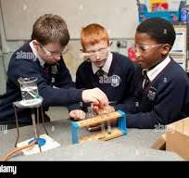
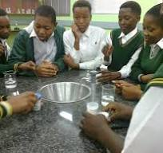
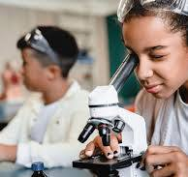
Practical work

Slide 2
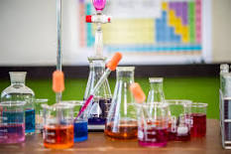
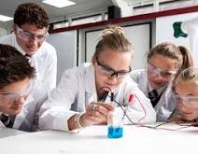
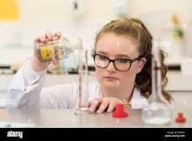

Slide 3
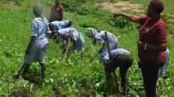
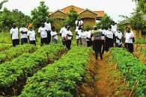
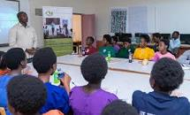

Slide 4
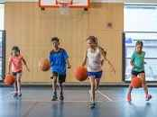


Slide 5
Understanding practical work
Practical work in refers to all kinds of experimental and observational activities, and in which reasoning is involved.
It actively engages students to explore and understand scientific concepts through the use of science processes.

Slide 6
Importance of practical work
Reinforcing concepts
For Skill Development:
Critical Thinking
Curiosity and Engagement:
Application of Knowledge
Safety Awareness
Teamwork and Collaboration
Cultural and Ethical Considerations
Memory Retention
Motivation for Further Study:

Slide 7
Examples of practical work taught to learners in primary schools
Observation of seeds, soils, fertilizers
Exploration of the environment resources such as wild life etc
Performing Simple Experiments
Measurement and Data Collection:
Life Sciences Activities
Earth Sciences Activities
Physics, biology and chemistry Activities
Weather and Climate Observations
Science Demonstrations

Slide 8
Types of practical work
Practical exercises
• Investigations
• Experiences

Slide 9
Practical exercises
These are routine laboratory experiments to verify a theory or determine a quantity and
involve the use of work sheets. A practical exercise has a format.
• Aim of experiment
• List of apparatus
• Method or procedure
• Results
• Conclusion

Slide 10
Examples of practical exercises are:
• To show that light travels in a straight line.
• To determine the boiling point of water.
• What happens when a candle burns?
• What are the conditions for rusting of iron?
• To determine the conditions necessary for germination of seeds.
• To show that leaves give off water vapour.
• To test for starch in foodstuffs.

Slide 11
Investigations
Investigation involves the use of the inquiry mind.
Investigation ideas and theories are generated and tested to confirm or refute them.
This experiment is designed and performed to investigate or test the ideas in an open-ended way. There may be more than one answer to an investigation.

Slide 12
Examples of investigations are:
• How can shoe polish be made?
• How does sound travel from one point to another?
• Where do seeds come from?
• Can enzymes be used to tenderize meat?

Slide 13
Experiences
These are investigations or explorations of problem solving nature linked with real life situations.
Experiences are important because they provide a feel for phenomena.
They help in developing a wide repertoire of process skills, in particular problem solving skills of scientific and technological nature.

Slide 14
Example of experiences are:
• Can a car fuel be obtained from sugar cane?
• How can bricks be made long lasting?
• How can fruit juice be preserved?
• How can work be made easier?
• What causes ebola disease?

Slide 15
Experiences are complex and involve a cycle process:
• Understanding the problem
• Devising strategies or plan
• Carrying out the plan
• Evaluating the solution.

Slide 16
Factors to consider when Organizing Practical Work
• Class size
• Availability of materials/resources
• Nature of practical work/experiment
• Instructional time.

Slide 17
Promoting practical science lessons
Invest in Laboratory Facilities
Teacher Training
Curriculum Integration
Use Everyday Materials
Outdoor Learning:
Collaboration with Local Communities
Interactive Science Kits:
ICT Integration:
Student-Led Investigations:
Showcasing Practical Science

Slide 18
Challenges associated with practical work
Resource Constraints:
Safety Concerns:
Time Constraints:
Large Class Sizes:
Inadequate Training:
Infrastructure Limitations:
Logistical Issues:
Assessment Difficulties
Access to Technology
Adaptation to Remote Learning

Slide 19
Integration of science into practical lessons
Preparation and Context Setting
Hands-On Demonstrations
Use Visual Aids
Connect with Everyday Experiences:
Encourage Questions and Discussions:
Provide Written Instructions:
Incorporate Predictions:
Reflect on Results
Formative Assessments:
Group Collaborations:
Integration with Literacy:

